Slide 1
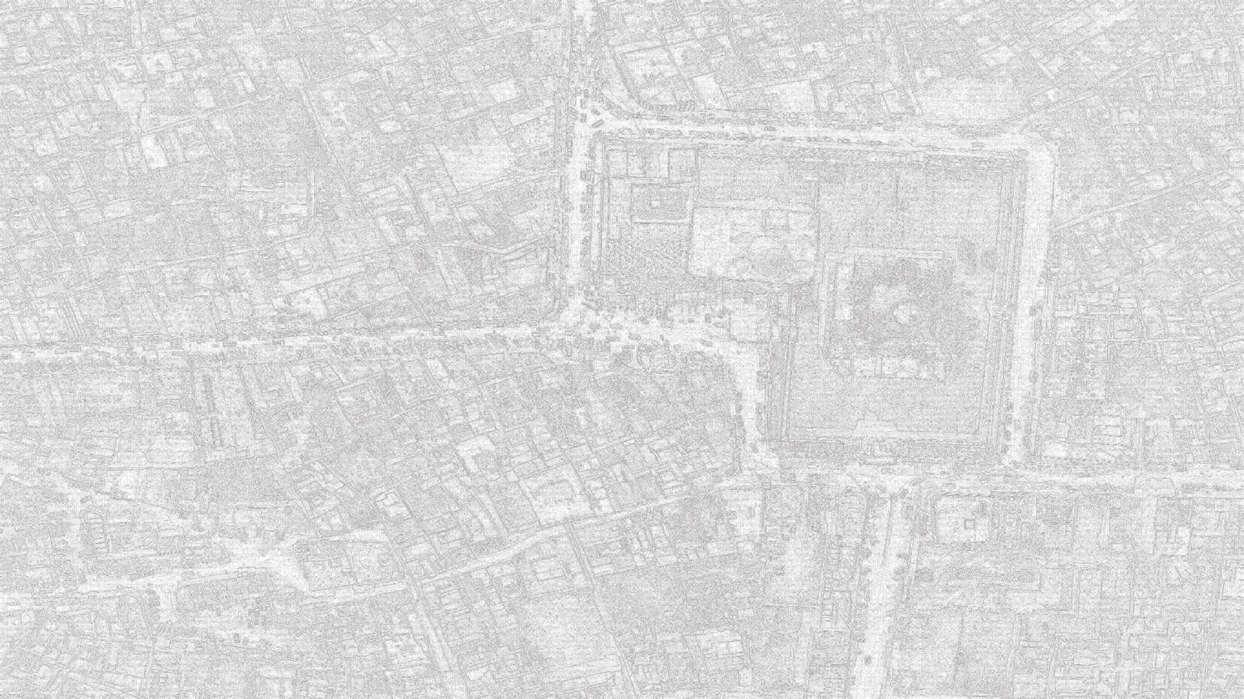

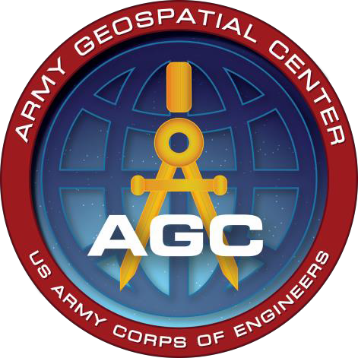


Presented by:
Richard A. Herrmann
Deputy Director

Slide 2





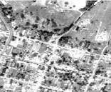
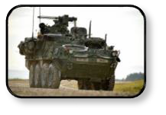

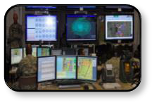
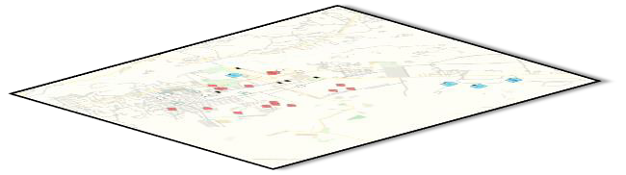
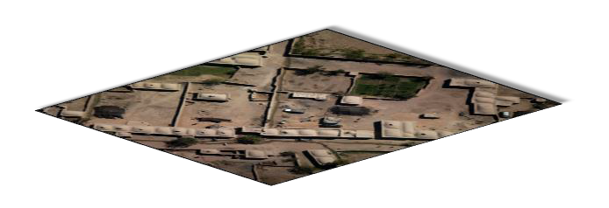





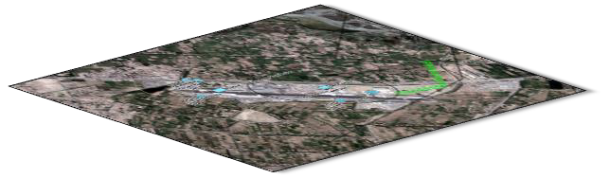
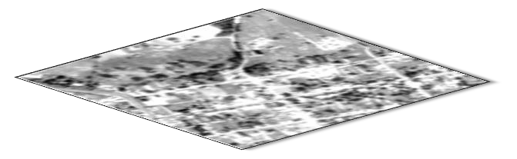

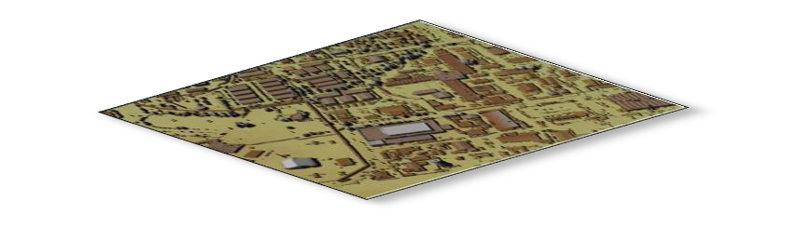




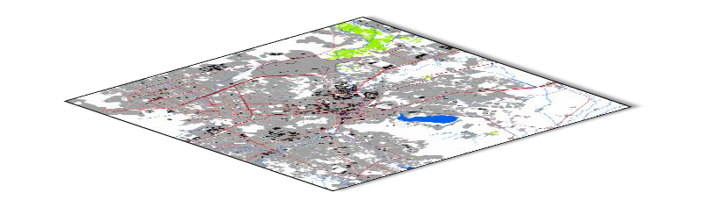

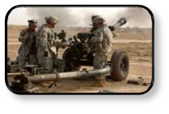

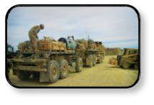
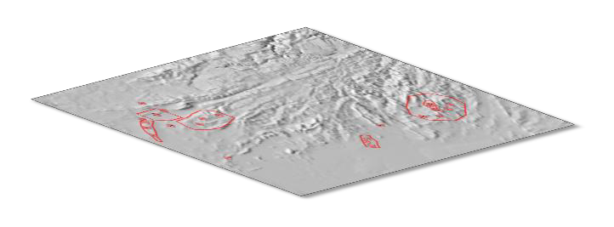



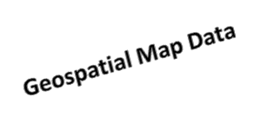

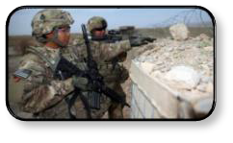
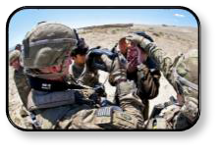
GEOSPATIAL INFORMATION
WHY IT’S IMPORTANT TO THE ARMY
It is a critical component of Geospatial-
Intelligence (GEOINT)…
Engagement
T-72 TANKS
Mission
Command
Movement & Maneuver
AMBUSH
IED
GEOINT
D
5
2
Y/1
2
1
35G / 350G
T-72 TANKS
Geospatial Information
12Y/125D
AMBUSH
IED
IMAGERY
IMAGERY INTELLIGENCE
Sustainment
Fires
GEOSPATIAL INFORMATION
And a cross-cutting capability required to conduct a variety of Uniform Joint Task and Army Universal Tasks, consequently critical to all Warfighting Functions.
Protection
Intelligence

Slide 3

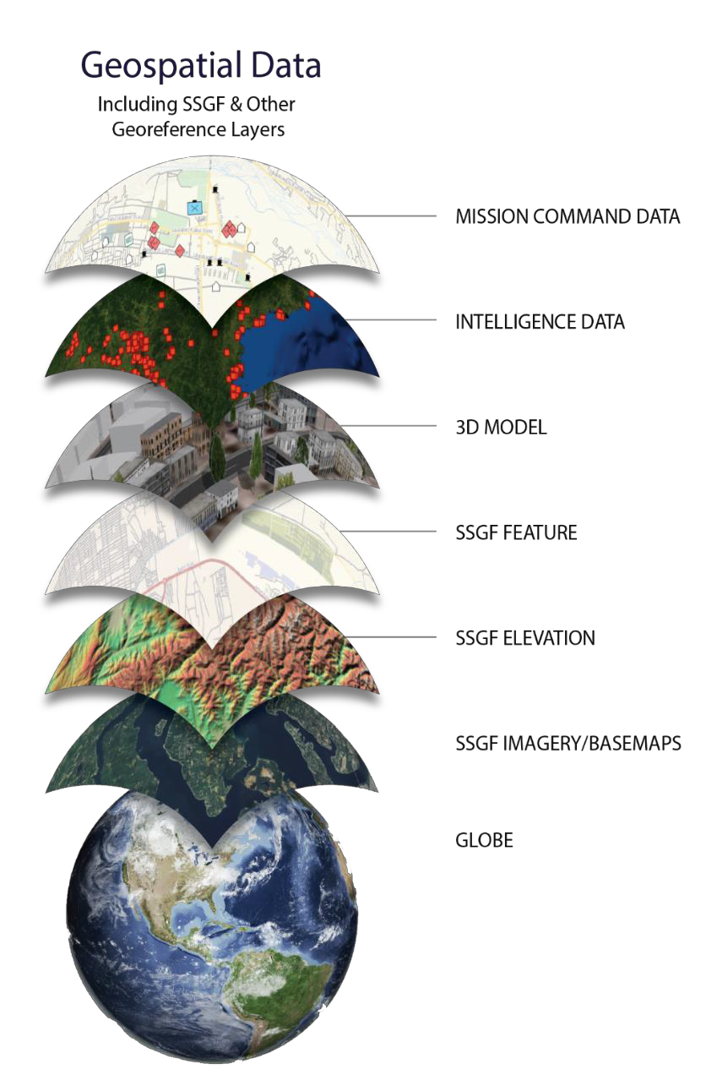



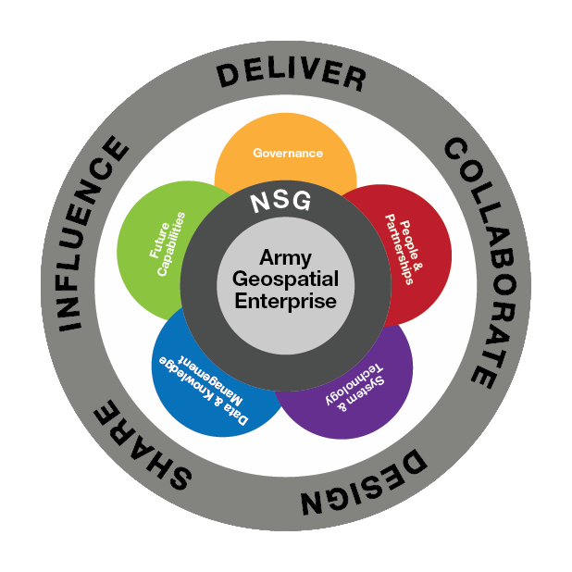
ENABLING THE AGE
Army Geospatial Enterprise:
An integrated system of technologies, standards, data, organizations and processes that delivers a Standard and Shareable Geospatial Foundation (SSGF) at all echelons.
The AGE:
Eliminates stove pipe systems
Consolidates geospatial data formats standards, schema/models, viewers and data management process
Ensures continuity of operations during
Relief in Place/Transfers of Authority (RIP/TOA)
Ensures the Army has the required
geospatial products and training

Slide 4































































CORPS OF ENGINEERS
has Multiple Roles involving Geospatial Engineering
Joint Capabilities Area Manager (JCAM) Operational Engineering
NGA
DoD GEOINT & NSG
Functional Manager
Chief of Engineers
Army Staff
Topographer of the Army
Commander
USACE
DCS, G-2
Geospatial Information Officer
Director, Geospatial Research
Laboratory
Chief of Branch
Engineer
Director, Army Geospatial
Center
CIO/G-6
Geospatial Data Steward
ASA(ALT)
Lead for Geospatial implementation within COE
Regimental Advisor Senior Mentor
Geospatial Engineering MOSs 125D/12Y

Slide 5








HOW WE ARE NOW ORGANIZED
AGC Executive Office
Director Deputy Director
Senior Geospatial Staff Officer
ERDC GRL
Director (ERDC & AGC/GRL) Deputy Director Division Chief Technical Director
Contracts Office
Strategic Communication & Plans Officer
Data Representation
Office of Counsel
Resource Management Office
Geospatial Applications
Geospatial Information Support Office
Data & Signature Analysis
Security, Plans and Operations Office
Info Generation & Mgt
Warfighter Support Directorate
Systems & Acquisition Support Directorate
Terrain Analysis
Military Support Team
Imagery Systems
Military & Civil Survey Engineering Support Branch
Hydrologic & Environ Analysis
Tactical Source
Systems Apps & Integration
Enterprise Support
Geospatial Data
GEOINT Support

Slide 6






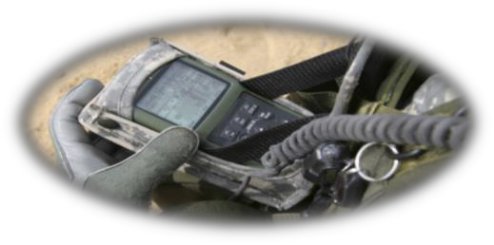

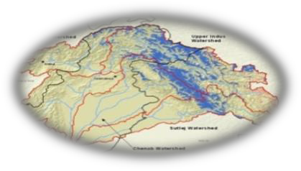
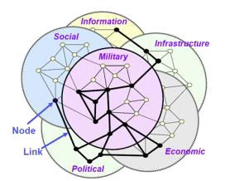










GEOSPATIAL RESEARCH AND ENGINEERING OVERVIEW
Geo-Enabled Computing Environments
Geospatial Engineering and Intelligence
Human Geography
GRE addresses capability gaps in establishing a flexible and adaptive Army Geospatial Enterprise (AGE) and the supporting analytics and services enabling all Warfighting Functions with particular focus on Intelligence Preparation of the Battlefield and Mission Command.
Implementing the AGE through a Standard and Sharable Geospatial Foundation (SSGF) and supporting analytics.
Geospatial capabilities for superior situational awareness; knowledge of the terrestrial impacts on all phases of unified land operations.
Knowledge of the theater environment including culture, terrain, climate, infrastructure, and demographics.
Remote Sensing and Assessment of Population Dynamics
Host Nation Stability Indicators
Operational Impacts of Infrastructure and Culture within Densely Populated/Complex Areas
Geospatial GMAD *
Mission Planning
Standards and Sharing
Analytics and Tactical Decision Aids
Data Representation and Geo-Narratives
Terrain/Environmental Analysis and Phenomenology
*Generation, Management, Analysis, Dissemination (AT 3-34.80 Geospatial Engineering)
Warfighter
TRADOC
Labs/Centers
Industry
CCMD
PEOs
Academia

Slide 7









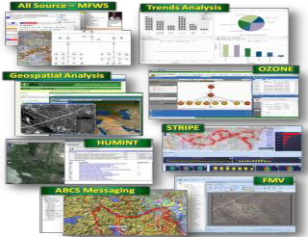
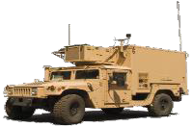










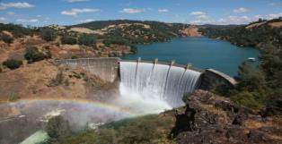
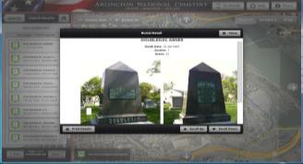
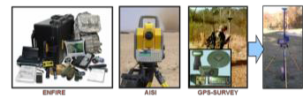
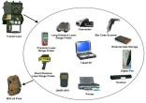








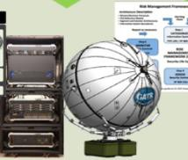

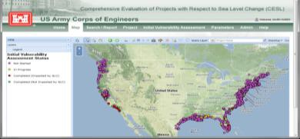
SYSTEMS ACQUISITION MISSION AREAS
GEOINT SUPPORT
FIELD & MAINTAIN GEOSPATIAL SYSTEMS
ESTABLISH AND SUSTAIN THE ARMY
SUPPORT TO CIVIL WORKS
SYSTEMS APPLICATIONS & INTEGRATION
GEOSPATIAL ENTERPRISE
Combat Terrain Info Systems:
  ENFIRE - Engr Recon Toolkit
  Total Station - Automated Optical Survey
  GPS– SAASM survey
  Joint Construction Mgmt and design build capabilities
  Army Dive team hydro survey
Partnering with ERDC to adopt:
  Environmental capabilities
  Site Selection
  Bridge health monitoring
  Construction/design tools
  REDI
  S&T initiatives enhancing construction management, surveying and reconnaissance
Future lead for Engineer Surveying Toolkit to modernize combat engineer and survey capabilities
Provide GEOINT domain support to DCGS-A
  Geospatial, IMINT, FMV, MTI
  Standard & Shareable Geospatial Foundation for the Army
  Systems Engineering to integrate national, theater and tactical intel
AGE Architecture
  GEOINT reference architecture
  COE reference architecture
AGE Standards
  Ground Warfighter Geospatial Data Model
  NSG/Army Standard implementation profiles
Systems Engineering
  AGE Node
  Geospatial Cross- Cutting Capabilities
  Trade Studies
Test and Certification
  GEOINT Test Threads
  AGE Certification in line with GFMSA
  Network Integration Evaluation Support
USACE Survey Engineering & Mapping Technical Center of Expertise
Inland Electronic Navigation Charts
Comprehensive Evaluation of Projects with Respect to Sea Level Change
USACE Survey Monument
Archival & Retrieval
National Inventory of Dams
Spatial Data Standards for Facilities, Infrastructure, and Environment
Special projects for DoD/Joint/Army/Intel Special Operations and State Department
DoD Support to Civil Authorities Automated Support System
Geospatially Enabled Arlington National Cemetery
Marine Corps Civil Information Management System
Command & Control of the Information Environment
NGA Water Security for Stability Operations
Overseas Humanitarian Assistance Shared Information System
Provide GEOINT domain support to TENCAP
  Integrate NSG Modernization
  Identify and harness new, emerging technologies
  Coordinate and Synchronize Army
GEOINT efforts

Slide 8








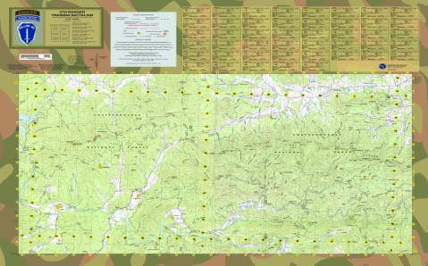


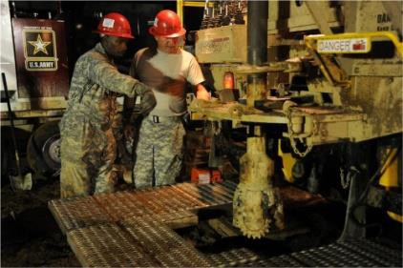
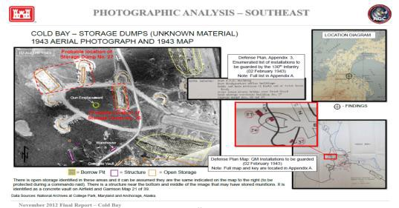



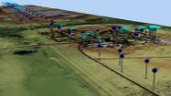

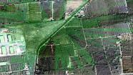




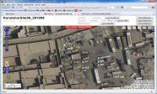
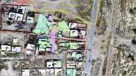
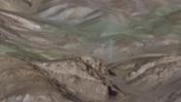
WARFIGHTER SUPPORT MISSION AREAS
EMAP: Army Geospatial Support
Water Resources
Historical Photo Analysis
HR3D Data Collection
Provides geospatial engineering support to both operating and generating forces
DoD’s primary agent for military water resource analysis and water detection
GIS-based historical photo analysis (HPA) focuses restoration and remediation efforts, leading to overall cost savings
High Resolution, Color, unclassified Imagery and Elevation Data that can be shared among interagency and international partners for both military and civilian applications
Provides reach-back support, training, technical and domain expertise to maneuver commanders, geoint teams, and generating forces to extend organic capabilities
Water Resource Data Base (WRDB): An enterprise geodatabase containing information on the location, quantity, quality, of land-based Surface, Ground, and Existing Water Facility features to support DoD water resource logistics decisions.
Identifies potential areas of environmental concern on U.S. Military installations:
Provides Situational Awareness / Understanding Terrain
Provides efficient and cost-effective solutions to make National and Service- level geospatial information mission and application ready
Hazardous, Toxic and Radioactive Waste (HTRW)
Enables Accuracy and Precision
Water Detection Response Team (WDRT):
Provides site selection analysis and water detection support to assist DoD military well drilling operations.
Unexploded Ordnance (UXO) under the Military Munitions Response Program (MMRP)
Reduces Casualties / Collateral Damage
Fills critical geospatial support and production gaps
Provides Required Foundation Data
Landfill Locations, Groundwater Contaminate Pathways, and Shoreline Changes

Slide 9


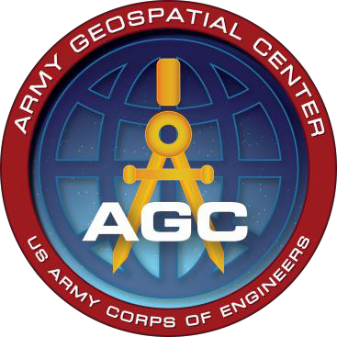
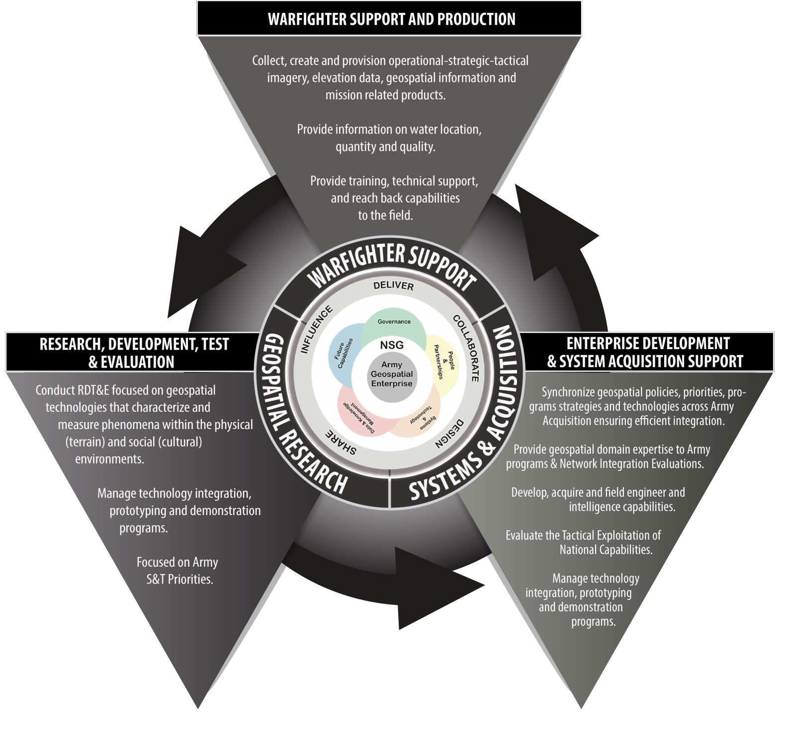
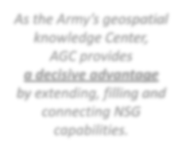








Component of Army Enterprise and NSG Architectures
Built on open source standards
Increases efficiency, reduces duplication, minimizes overhead
Enables Enterprise Collaboration
Enables Common Operating Picture
Improves continuity of operations during unit RIP/TOA
VISION: Enabling geospatial
information dominance.
MISSION: Providing timely, accurate, and relevant geospatial information, capabilities, and domain expertise for Army Geospatial Enterprise implementation in support of unified land operations.
As the Army’s geospatial
knowledge Center,
AGC provides
a decisive advantage by extending, filling and connecting NSG capabilities.
Facilitates data
sharing
Enables Adaptive Planning
Shapes commercial sector IT advances

